Slide 1
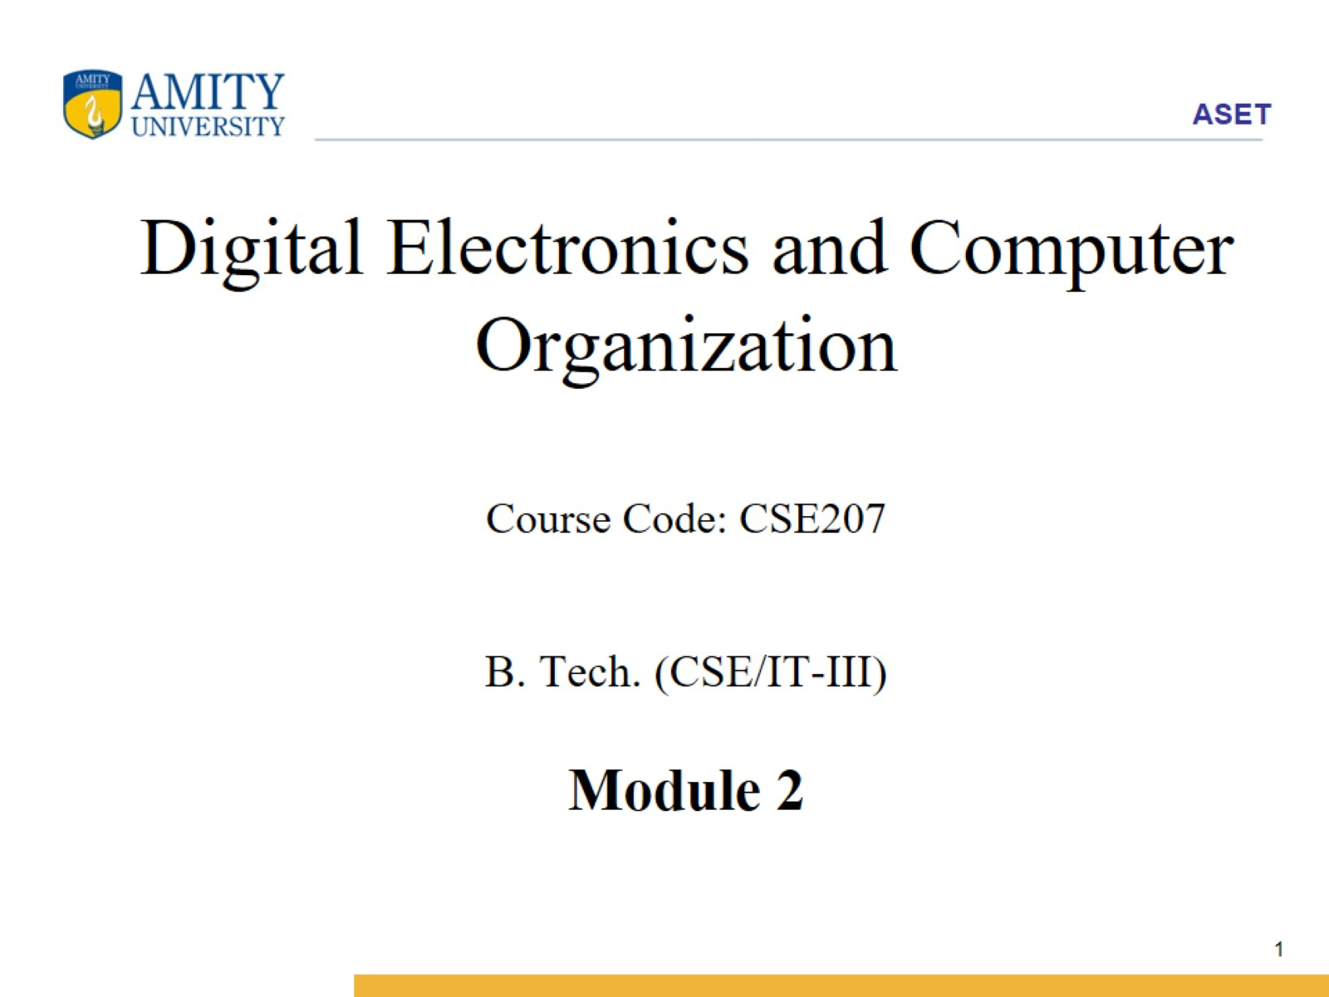
Digital Electronics and Computer Organization Course Code: CSE207 B. Tech. (CSE/IT-III) Module 2

Slide 2
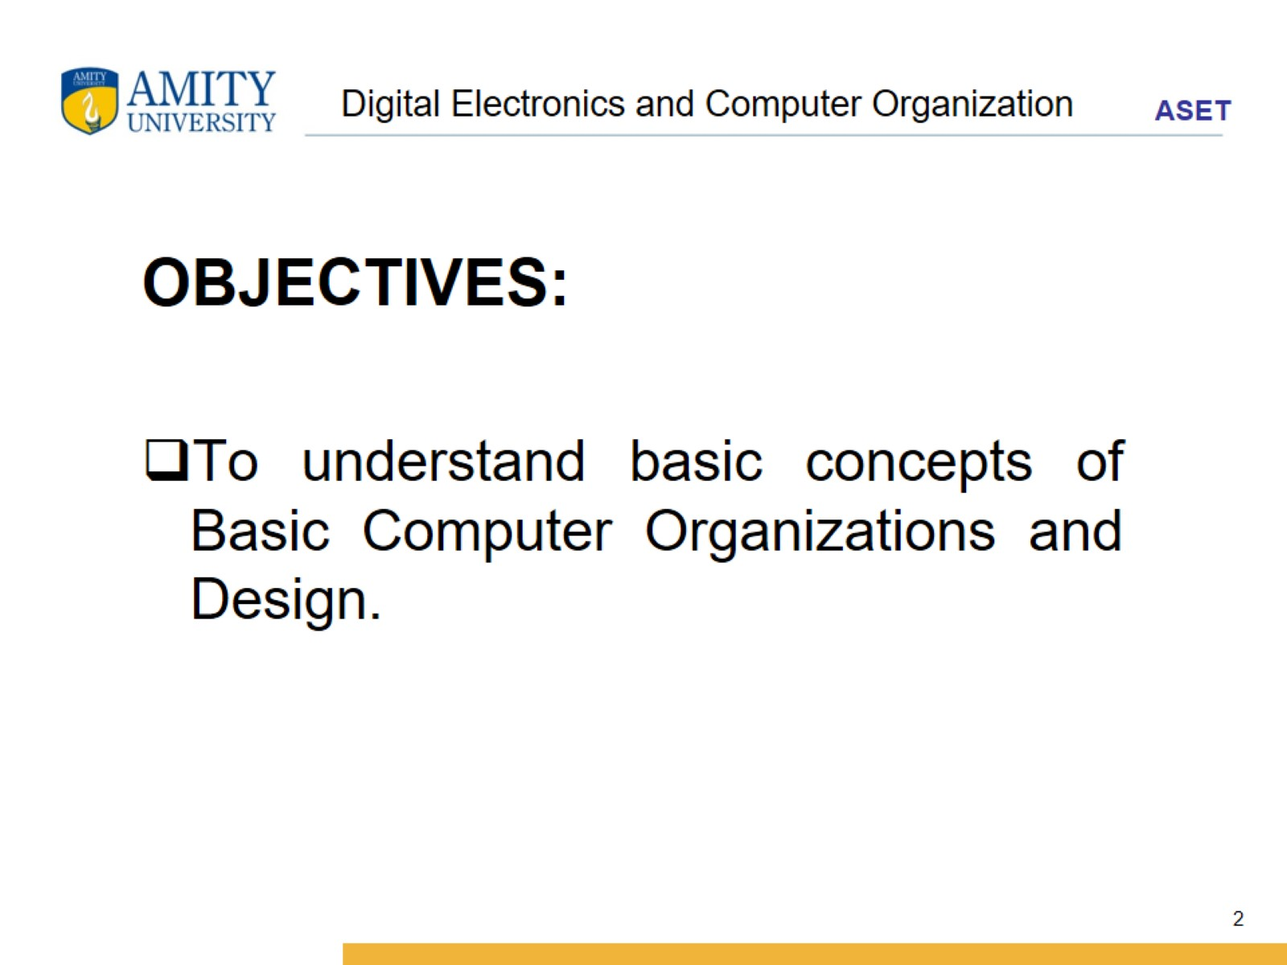
Digital Electronics and Computer Organization

Slide 3
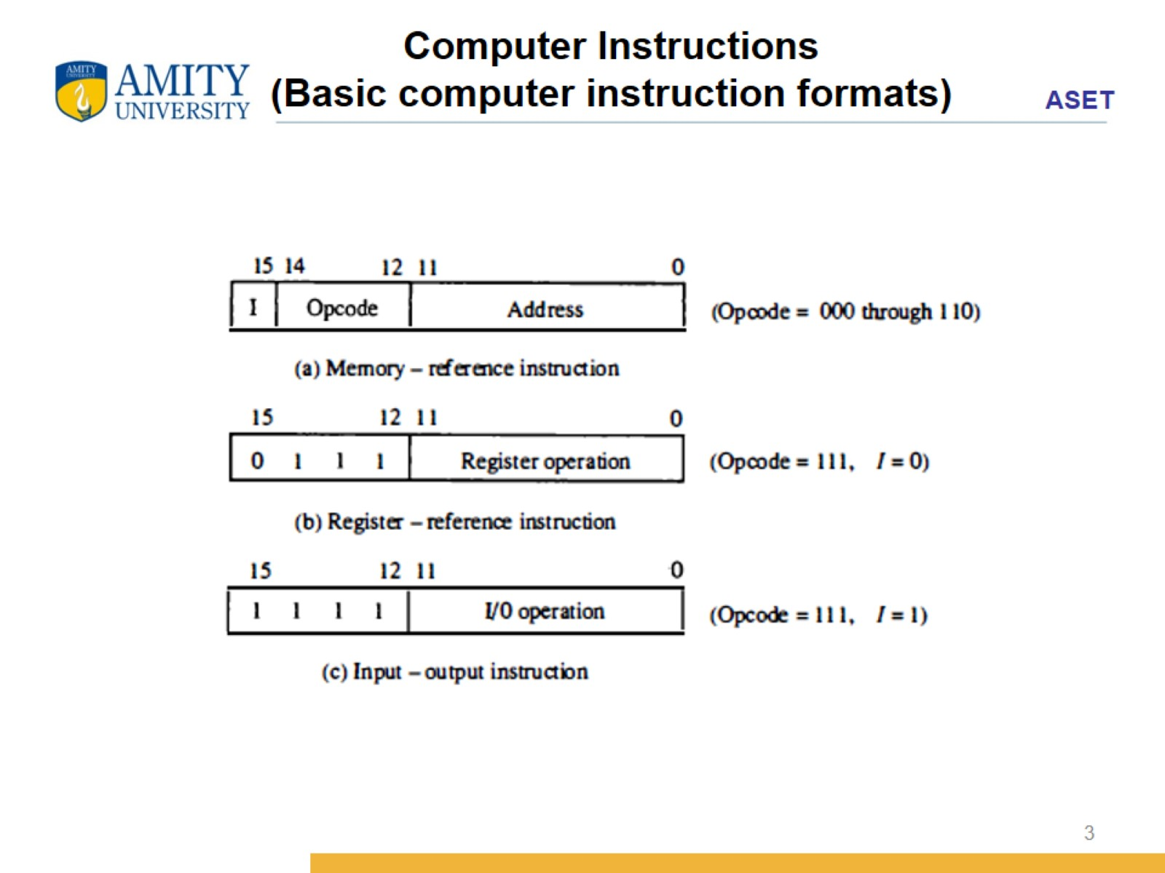
Computer Instructions (Basic computer instruction formats)

Slide 4
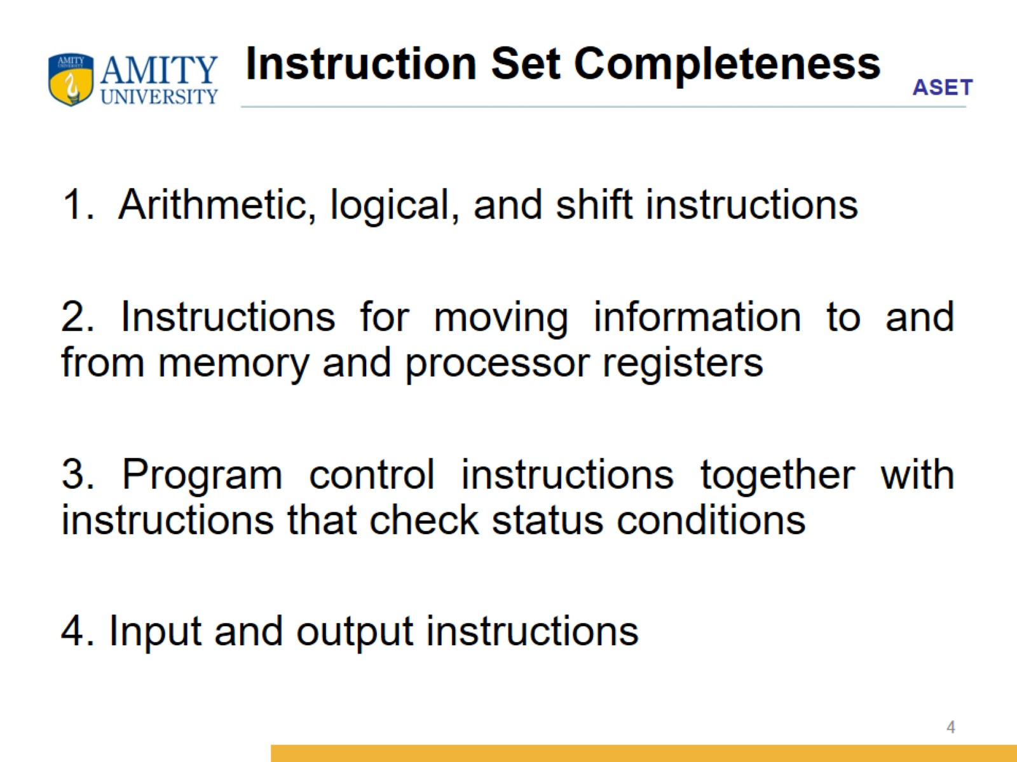
Instruction Set Completeness

Slide 5
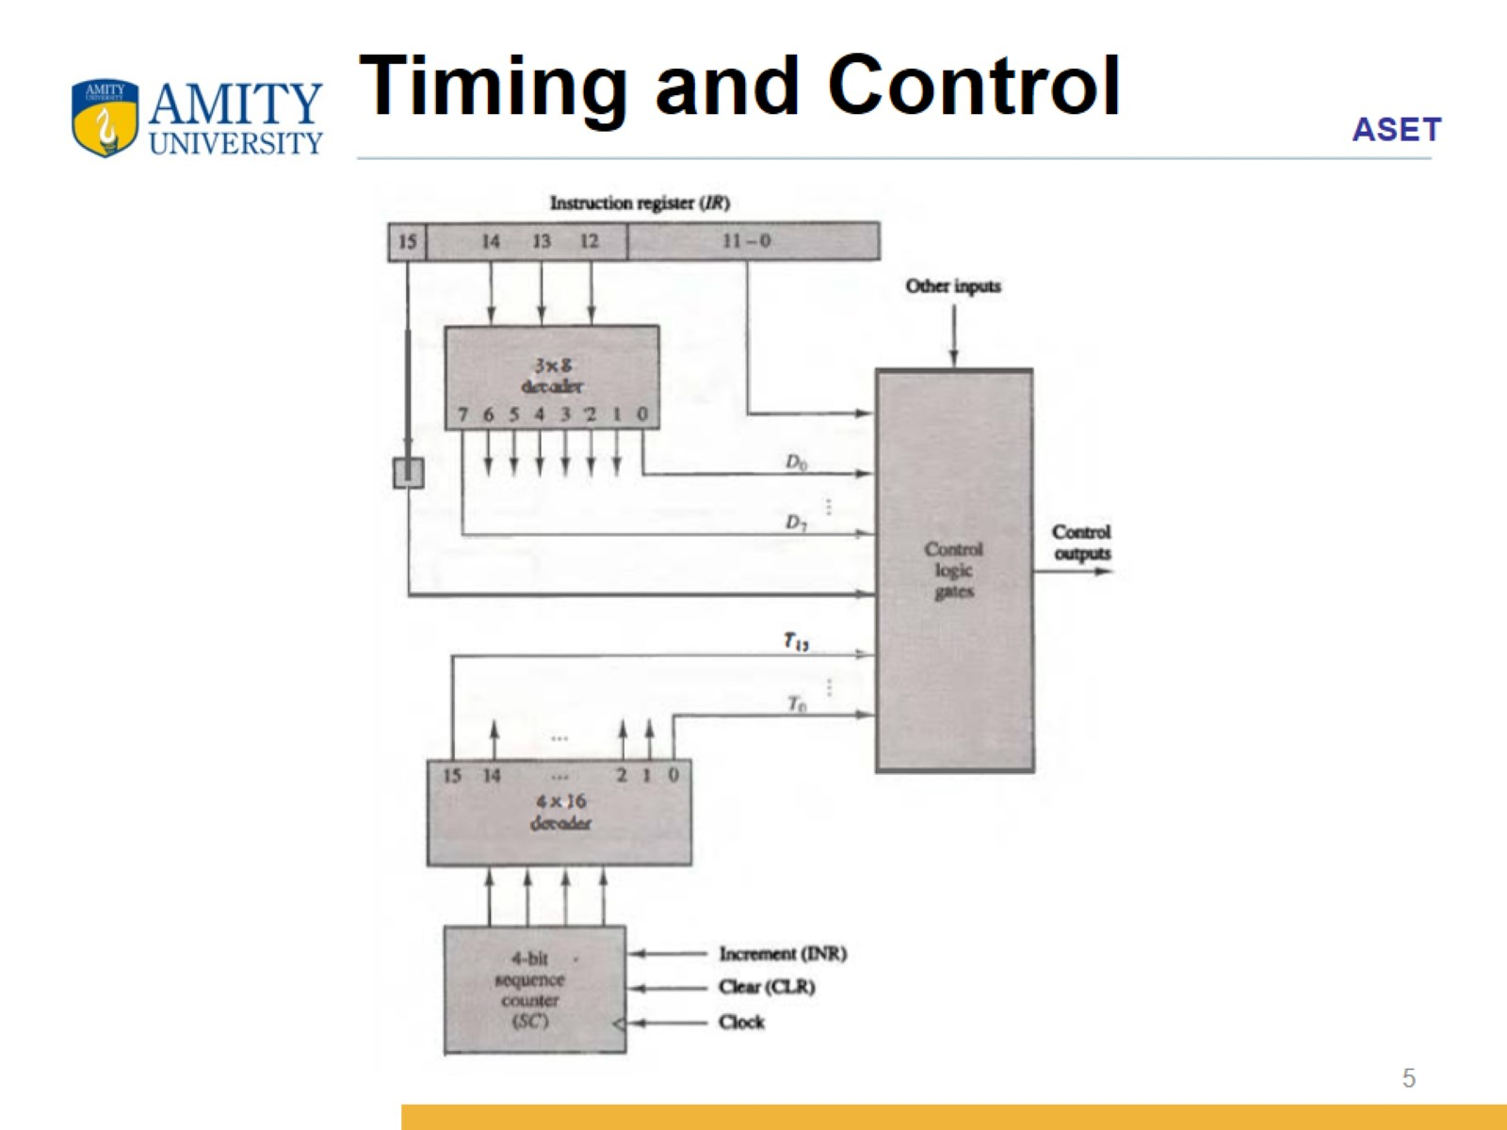
Timing and Control

Slide 6
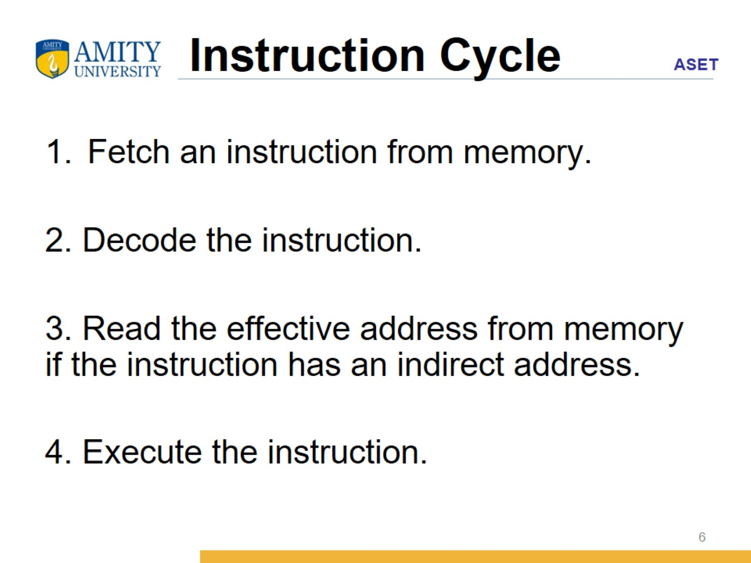
Instruction Cycle

Slide 7
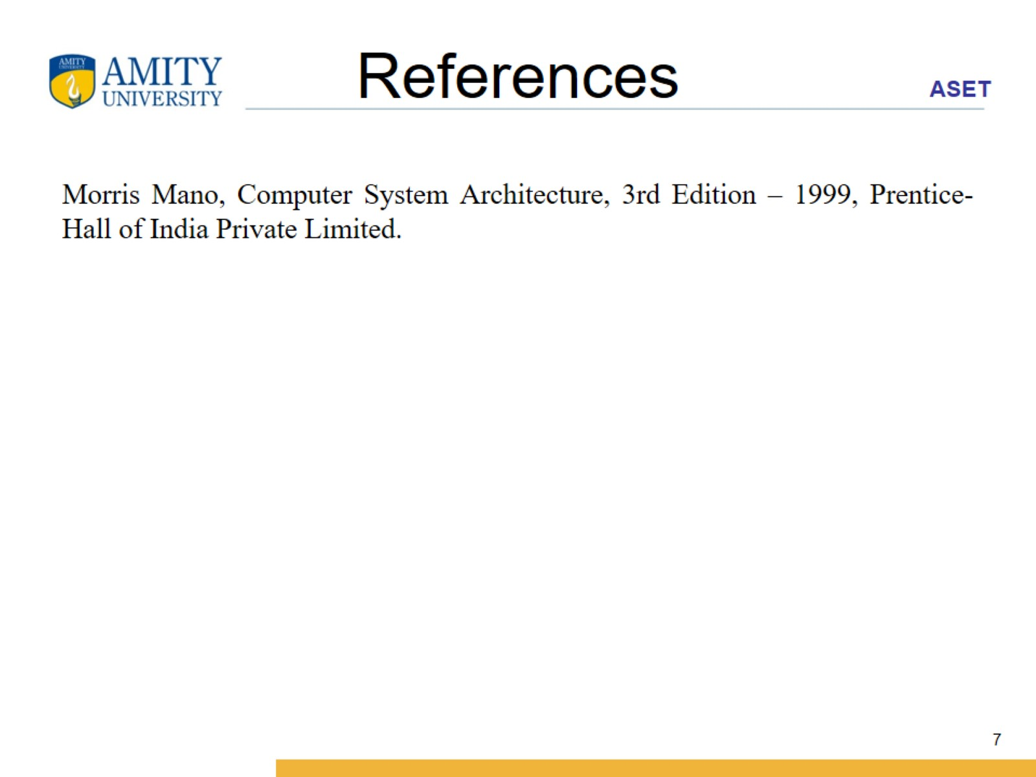
References

